Slide 1
File System

Slide 2
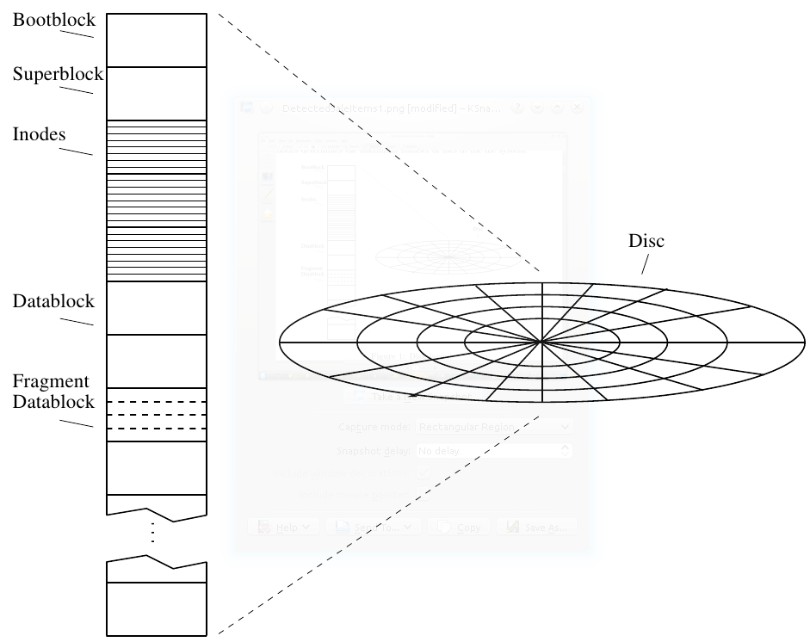
Typical Unix File System Parts
A ﬁle system is created with mkfs.
Parts of a filesystem:
Bootblock - contains a primary boot program for the OS,
Superblock - static parameters of the ﬁle system, like total size, block size, …
inodes - stands for index node (file headers);
The number of inodes determines the maximum number of ﬁles in the ﬁle system.
Data blocks – each has typically a size of 4 or 8 Kbytes ;

Slide 3
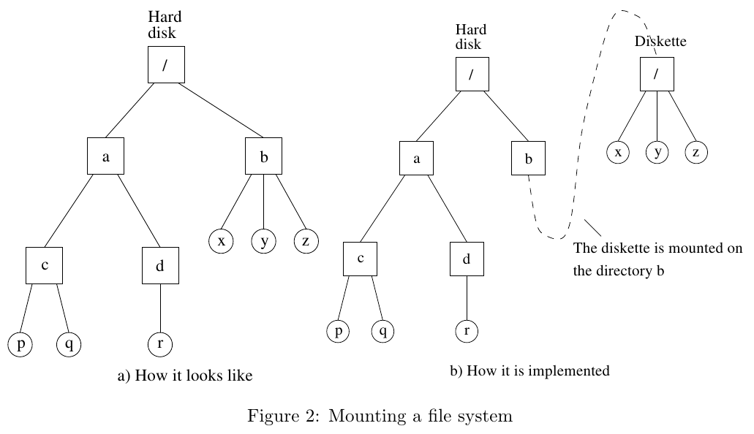
File System Structure

Slide 4
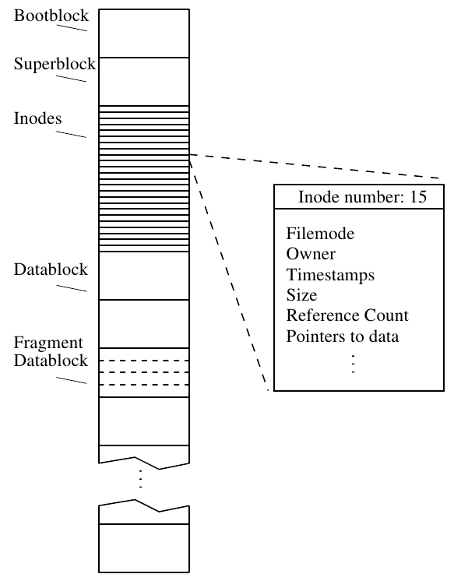
inode
A ﬁle consists of exactly one inode, and zero or more data blocks.
An inode is a structure used to maintain information about the ﬁle.
It includes ﬁelds for the following :
ﬁle mode
owner (user and group)
timestamps (three diﬀerent)
size (bytes, blocks)
reference count
pointers to data
Important: A ﬁle does NOT have a name. The ﬁle is uniquely identiﬁed by its inode number. So where a file name stored?!

Slide 5
File Mode
The file mode is normally referred to as permissions, but it also contains information about the type of file.
When you do a ls -l, you see something like this:
lrwxrwxrwx 1 user group file1
-rw-r--r-- 1 adavid docs file2
The first bits identify as one of:
a regular file: -
a directory: d
a symbolic link: l
some other things (see the manual page for stat for details)
More details… dir permissions…

Slide 6
Timestamps
There are three timestamps defined:
modification time (mtime) - when the file was last changed
access time (atime) - when the file was last read
status time (ctime) - when certain changes was made to the inode

Slide 7
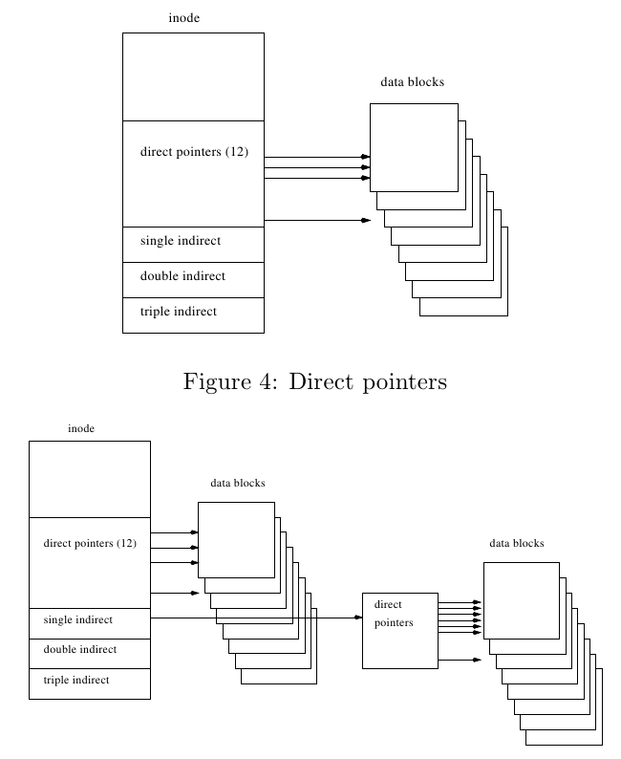
Inode Block Pointer

Slide 8
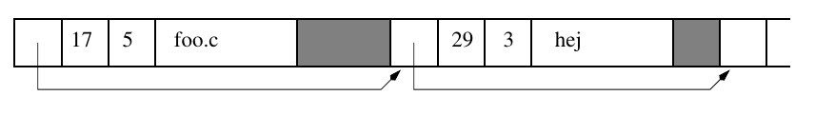
Directories
Directories are files, but they are treated differently.
A directory can be identified by its mode bytes.
A directory is a file that consists of a number of records, each of which contains the following fields:
a pointer to the next record
a number identifying an inode (i.e. another file)
a number identifying the length of the record
a string containing the name of the record.
It is this name we usually refer to as a filename. Note that it is part of the directory, and not part of the file.
If you type ls -li in the directory, you will have the following
17 -rw-r--r-- 1 (...) foo.c
29 -rwxr-xr-x 1 (...) hej

Slide 9
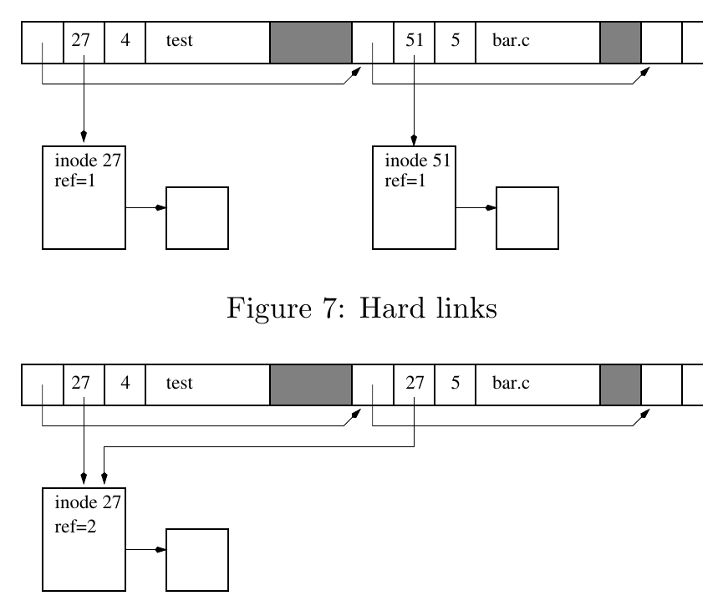
Hard Links
By associating a name in a directory with a file we get what is known as a hard link
The directory in figure 7 contains links to inodes 27 and 51, so we can refer to file 27 as ”test” and file 51 as ”bar.c”.
> ls -li
51 lrwxrwxrwx 1 (...) bar.c
27 -rw-r--r-- 1 (...) test
We can have more than one hard link to a file.
In figure 8, the reference counter in inode 27 will be 2 because there are two links to the inode,
With ls -i, we can see the 2 files bar.c and test have the the same inode number (27).
There is absolutely no difference between the files (they are the same file with 2 names), and the links (hard links) do not need to be in the same directory.
> ls -li
27 -rw-r--r-- 2 (...) bar.c
27 -rw-r--r-- 2 (...) test
Hard links can be created using the command ln in the shell or the link system call.
Can’t create a hard link to a directory,
Can’t create hard links across file systems (why?!)

Slide 10
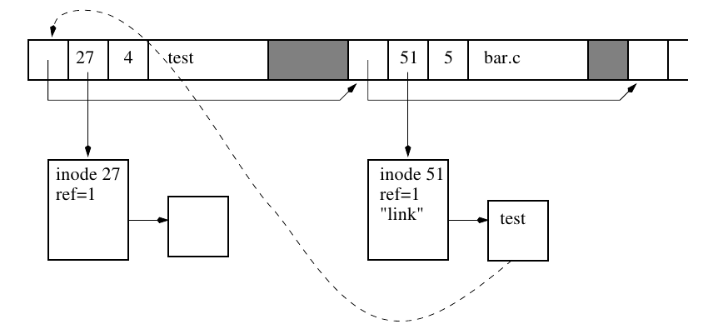
Symbolic or Soft Links
Like Windows shortcuts,
Symbolic links are different from hard links.
A symbolic link is actually a separate file, whose contents is the name of another file or directory.
A mode bit indicates that a file is to be interpreted as a symbolic link.
ls -li in figure 9:
51 lrwxrwxrwx 1 (...) bar.c -> test
27 -rw-r--r-- 1 (...) test
Symbolic links are created with the command ln or the system call symlink.
Can be created to dirs,
Can be created across filesystems (how?!)
Broken link?
How to create using ln ?

Slide 11
File Creation
To create a file we use the open system call with some arguments to tell it to create a file.
When you do this a free inode is found and initialized and an entry is created in the current directory to point to the inode.
Initially the file is empty, that is, there are no data blocks.

Slide 12
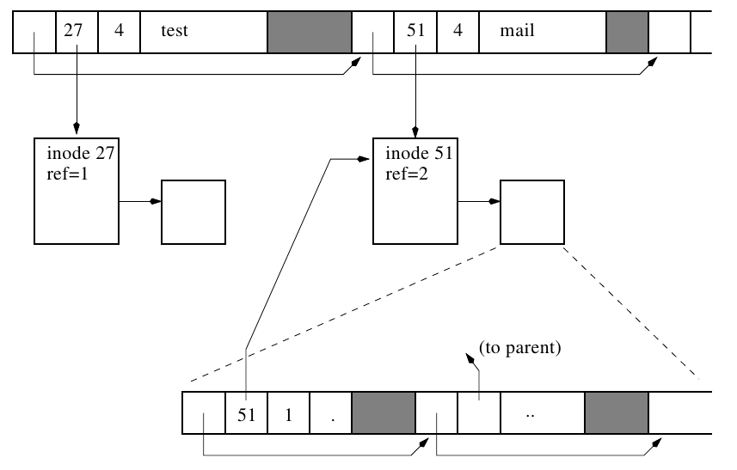
Directory Creation
To create a directory we can use command/syscall mkdir
When creating a directory the following happens:
A file is created (i.e. an inode is allocated), and it is identified as a directory.
Then a link to this inode is created in the current directory (which we are to create new dir within it!),
In the new directory two entries are created:
”.” points to the directory’s own inode
”..” points to the parent’s inode

Slide 13
Removing Files
To remove a file we use the shell command rm or the system call unlink.
When you do this the following happens:
First the directory entry is freed and the record pointer of the previous entry is reset.
Then the inode reference counter is decreased by one, and if it reaches zero, the data blocks and the inode are freed.

Slide 14
Mounting File Systems
The Linux File System makes it appear as if all the File System are local and mounted somewhere on the root File System.
File System are mounted with the mount command.
mount –t type source mount_point
To unmount a File System, the umount command is used.
umount /dev/<device name> or mount_point
How mount a flash disk?

Slide 15
Absolute vs. Relative Paths
ls /home/user/somedir/somefile
cd /home/user
ls somedir/somefile

Slide 16
Some Commands
ls
df –h
fdisk –l
cd
pwd
mkdir
touch
nano
ln
root user, sudo, su
chmod
cat
man

